Slide 1
Network analysis
Homework:
Draw the network and identify the critical path.
Activity | Preceding Activity | Duration [weeks]
A | None | 4
B | None | 6
C | A, B | 7
D | B | 8
E | B | 5
F | C | 5
G | D | 7
H | D, E | 8
I | F, G, H | 4

Slide 2
Network analysis
Revision Example
Western Hills Shopping Center
The owner of the Western Hills Shopping Center is considering modernising and expanding the current 32-business shopping complex.
Financing for the expansion has been arranged through a private investor.
If the expansion project is undertaken, the owner hopes to add 8 to 10 new businesses to the shopping center.

Slide 3
Revision Example
The activities that make up the expansion project are listed in table below.
Activity | Activity description |  | Immediate Predecessor | Duration [weeks]
A | Prepare architectural drawings |  | None | 5
B | Identify potential new tenants |  | None | 6
C | Develop prospectus for tenants |  | A | 4
D | Select contractor |  | A | 3
E | Prepare building permits |  | A | 1
F | Obtain approval for building permits |  | E | 4
G | Perform construction |  | D, F | 14
H | Finalise contracts with tenants |  | B, C | 12
I | Tenants move in |  | G, H | 2
 |  | Total : |  | 51

Slide 4
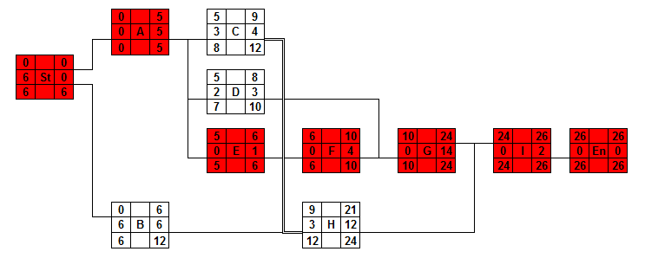
Revision Example
Solution:
CP: St – A – E – F – G – I – End
Time: 26 weeks

Slide 5
Revision Example
Project Management & Control using CPM
Please assess the impact of the following pieces of information on the project progress:
Activity D will take one additional week due to the sickness of the relevant employee.
Activity A has been shortened to 4 weeks only.
It is the week number 7 now and activity F has not started yet.
Activity C has been finished on time (9th week).
Team that has started their work on the activity H on time announced that due to bad economic situation they will need 16 weeks to finish the contracts with tenants.

Slide 6
Network analysis
Contributions of CPM:
What is the total time to complete the project?
What are the scheduled start and completion times for each activity?
Which activities are "critical" and must be completed exactly as scheduled in order to keep the project on schedule?
and furthermore
Exactly same pieces of information could be used in scheduling, managing and controlling the project!

Slide 7
Resource Smoothing
Activity Scheduling and Resource Allocation / Resource Smoothing
An important consideration in the scheduling of activities is the effect on resource requirements over time.
There might be a limit on the availability of one or more resources, which will serve to constrain the timing of activities.
Moreover, it is easier to control the costs of the project if there is a relatively even load on all resources.

Slide 8
Resource Smoothing
Activity Scheduling and Resource Allocation / Resource Smoothing
It is very expensive (and sometimes even impossible) to hire and fire employees, to bring in and move out expensive pieces of technology etc.
An even load means that the minimum of resources can be employed to a high level of utilization.
It is very difficult to achieve even load in practice and therefore we try to smooth resources (to level the resources overload).

Slide 9
Resource Smoothing
How to achieve it?
We can use some useful pieces of information provided by CPM.
By using some of the float on non-critical activities to delay the start of those activities it is possible to smooth out loads.
And of course, it is very difficult or even impossible to smooth multiple resources at a time and therefore it is necessary to decide which resource to smooth.

Slide 10
Resource Smoothing
It is worthwhile to smooth
- the resource that is the most expensive to hire
(e.g. unique specialist, foreign expert)
- the resource that is the most overloaded
(e.g. lecture rooms, beds in hospital)
- the resource that is the least flexible
(e.g. crane, special equipment)
- or the resource that is the most used on the project
(e.g. workers, transportation).

Slide 11
Resource Smoothing
Example: Consider the following project including the given data concerning workers needed for each task.
Activity | Duration [hours] | Preceding activity | Men Required
A | 2 | none | 2
B | 4 | none | 3
C | 4 | A | 2
D | 6 | B | 1
E | 4 | C, D | 3

Slide 12
Resource Smoothing
At the beginning we will utilize CPM as we did before.
 |  |  |  |  |  | 0 |  | 2 |  |  | 2 |  | 6
 |  |  |  |  |  | 4 | A | 2 |  |  | 4 | C | 4
 |  |  |  |  |  | 4 |  | 6 |  |  | 6 |  | 10
 | 0 |  | 0 |  |  |  |  |  |  |  |  |  |  |  |  | 10 |  | 14 |  | 14 |  | 14
 | 0 | St | 0 |  |  |  |  |  |  |  |  |  |  |  |  | 0 | E | 4 |  | 0 | End | 0
 | 0 |  | 0 |  |  |  |  |  |  |  |  |  |  |  |  | 10 |  | 14 |  | 14 |  | 14
 |  |  |  |  |  | 0 |  | 4 |  |  | 4 |  | 10
 |  |  |  |  |  | 0 | B | 4 |  |  | 0 | D | 6
 |  |  |  |  |  | 0 |  | 4 |  |  | 4 |  | 10

Slide 13
Resource Smoothing
We will redraw it in a for of Gantt chart considering that all activities start at earliest start times.
 | Time | 1 | 2 | 3 | 4 | 4 | 6 | 7 | 8 | 9 | 10 | 11 | 12 | 13 | 14
 | A | 2 | 2
 | B | 3 | 3 | 3 | 3
 | C |  |  | 2 | 2 | 2 | 2
 | D |  |  |  |  | 1 | 1 | 1 | 1 | 1 | 1
 | E |  |  |  |  |  |  |  |  |  |  | 3 | 3 | 3 | 3
 | Total | 5 | 5 | 5 | 5 | 3 | 3 | 1 | 1 | 1 | 1 | 3 | 3 | 3 | 3

Slide 14
Resource Smoothing
We can see that the workload is rather unfortunate and uneven.

Slide 15
Resource Smoothing
We will redraw it in a for of Gantt chart considering that all activities start at earliest start times.
 | Time | 1 | 2 | 3 | 4 | 4 | 6 | 7 | 8 | 9 | 10 | 11 | 12 | 13 | 14
 | A | 2 | 2
 | B | 3 | 3 | 3 | 3
 | C |  |  | 2 | 2 | 2 | 2
 | D |  |  |  |  | 1 | 1 | 1 | 1 | 1 | 1
 | E |  |  |  |  |  |  |  |  |  |  | 3 | 3 | 3 | 3
 | Total | 5 | 5 | 5 | 5 | 3 | 3 | 1 | 1 | 1 | 1 | 3 | 3 | 3 | 3

Slide 16
Resource Smoothing
We can postpone some non-critical activities in order to ballance the workload (activities A and C are delayed).
 | Time | 1 | 2 | 3 | 4 | 4 | 6 | 7 | 8 | 9 | 10 | 11 | 12 | 13 | 14
 | A |  |  |  |  | 2 | 2
 | B | 3 | 3 | 3 | 3
 | C |  |  |  |  |  |  | 2 | 2 | 2 | 2
 | D |  |  |  |  | 1 | 1 | 1 | 1 | 1 | 1
 | E |  |  |  |  |  |  |  |  |  |  | 3 | 3 | 3 | 3
 | Total | 3 | 3 | 3 | 3 | 3 | 3 | 3 | 3 | 3 | 3 | 3 | 3 | 3 | 3

Slide 17
Resource Smoothing
We can see that the workload has been levelled.

Slide 18
Resource Smoothing
Comparison „before“ and „after“ resource smoothing.

Slide 19
Assignment
Construct a network, calculate the total project time, and use a bar chart presentation to illustrate the number of staff required week by week assuming each activity starts at its earliest time.
Try to smooth out the loads by using some of the float on non-critical activities.
Activity | Preceding activity | Duration [weeks] | Staff Required
A | none | 5 | 3
B | none | 3 | 3
C | A | 2 | 4
D | A, B | 3 | 9
E | C | 3 | 4
F | D | 7 | 5
End | E, F | 0 | 0

Slide 20
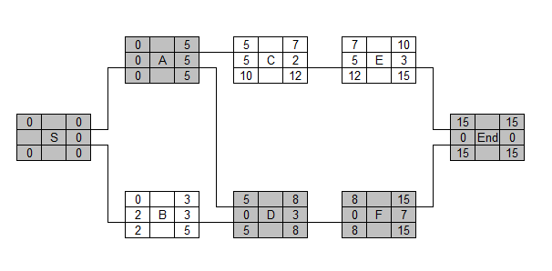
Assignment
Network:

Slide 21
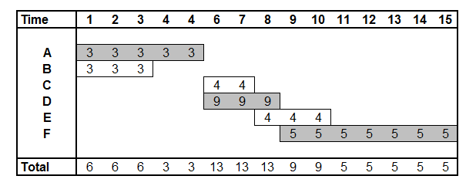
Assignment
Gantt Chart:

Slide 22
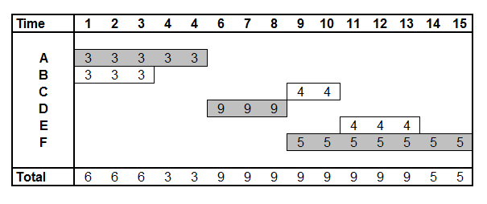
Assignment
Gantt Chart after smoothing:

Slide 23
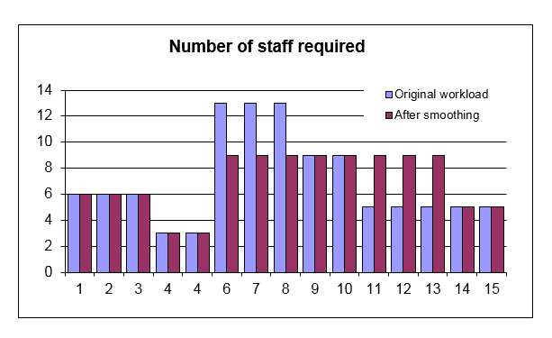
Assignment
Gantt Chart after smoothing:

Slide 24
Assignment 2
You are one of three carpenters assigned to complete a short construction project. Unfortunately, right before the start of the project, one of your fellow carpenters was hospitalized and will be unable to work on the project. Are two carpenters only able to complete the project within originally promised 15 days?
Activity | Preceding activity | Duration [days] | Carpenters required
A | None | 2 | 2
B | A | 1 | 2
C | A | 3 | 2
D | B,C | 1 | 2
E | D | 2 | 2
F | D | 3 | 1
G | E | 2 | 2
H | F, G | 2 | 2

Slide 25
Homework
A company specializing in the erection of home swimming pools have broken the activities down as shown below. Also given in the table is the number of staff required.
Construct a network, calculate the total installation time, and use a bar chart presentation to illustrate the number of staff required week by week assuming each activity starts at its earliest time.
Determine if it is possible to complete the project in the shortest possible time without ever employing more than ten staff simultaneously on the site.

Slide 26
Homework
Activity | Preceding activity | Duration [weeks] | Staff Required
A | none | 2 | 2
B | none | 4 | 3
C | A | 3 | 2
D | A | 5 | 4
E | A | 1 | 3
F | C | 2 | 3
G | D | 5 | 3
H | B, E | 7 | 3
I | H | 2 | 2
J | F, G, I | 3 | 1

